Slide 1

-:Project 1:- Deployment Of Static Website on AWS

Slide 2

Contents :-
Introduction To AWS
Static Website
Deploy A Static Website On AWS
(i).Definition.
(ii). Stages of Deploy a website

Slide 3
:-Introduction To AWS:-
1.Cloud Computing is the on – demand delivery of IT
resources over the internet.
2.Instead of buying, maintaining physical data in
market we can use cloud storage.

Slide 4
-:Static Website:-
Static Website is website in which you cannot change the content.
For static website you must have the knowledge in HTML,CSS , or any CSS framework like bootstrap.

Slide 5
-:Deploy A Static Website On AWS:-
Web Applications Deployment is the process in which we
upload a source code on a server which user can access with internet.

Slide 6
Stages Of Deploy A Static Website
Local
Development
Staging
Live

Slide 7

Steps for deploy a static website on aws
Step 1: Create a bucket.
* To creat a s3 bucket
Sign in to the AWS Management Console and open the Amazon S3 console at https://console.aws.amazon.com/s3/
Choose Create bucket.
Enter the Bucket name (for example, example.com).
Choose the Region where you want to create the bucket.
Now choose the creat button.

Slide 8
Step 2: Enable static website hosting.
*After you create a bucket, you can enable static website hosting for your bucket. You can create a new bucket or use an existing bucket.*
In the Buckets list, choose the name of the bucket that you
want to enable static website hosting for.
Choose Properties.
Under Static website hosting, choose Edit.
Choose Use this bucket to host a website.
Under Static website hosting, choose Enable.
In Index document, enter the file name of the index
document, typically index.html.

Slide 9
Choose Save changes.
Under Static website hosting, note the Endpoint.
The Endpoint is the Amazon S3 website endpoint for your bucket.
After you finish configuring your bucket as a static website, you can
use this endpoint to test your website.
Step 3: Edit Block Public Access settings
Open the Amazon S3 console
at https://console.aws.amazon.com/s3/.
Choose the name of the bucket that you have
configured as a static website.
Choose Permissions.
Under Block public access (bucket settings),
choose Edit.

Slide 10
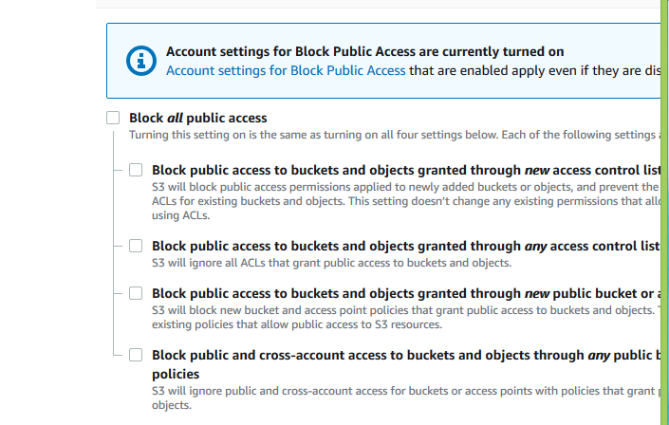
Clear Block all public access, and choose Save changes.

Slide 11
Step 4: Add a bucket policy that makes your
bucket content publicly available
*After you edit S3 Block Public Access settings, you can add a bucket policy to grant public read access to your bucket. When you grant public read access, anyone on the internet can access your bucket.*
Under Buckets, choose the name of your bucket.
Choose Permissions.
Under Bucket Policy, choose Edit.
To grant public read access for your website, copy the following
bucket policy, and paste it in the Bucket policy editor.

Slide 12
{
"Version": "2012-10-17",
"Statement": [
{
"Sid": "PublicReadGetObject",
"Effect": "Allow",
"Principal": "*",
"Action": [
"s3:GetObject"
],
"Resource": [
"arn:aws:s3:::Bucket-Name/*"
]
}
]
}
Update the Resource to your bucket name
. Choose Save changes.

Slide 13
To configure the index document
Create an index.html file.
If you don't have an index.html file, you can use the following HTML to create one:
<html xmlns="http://www.w3.org/1999/xhtml" >
<head>
<title>My Website Home Page</title>
</head>
<body>
<h1>Welcome to my website</h1>
<p>Now hosted on Amazon S3!</p>
</body>
</html>
*Save the index file locally*
Sign in to the AWS Management Console and open the Amazon
S3 console at https://console.aws.amazon.com/s3/.
In the Buckets list, choose the name of the bucket that you
want to use to host a static website.

Slide 14
Enable static website hosting for your bucket, and enter the exact
name of your index document (for example, index.html). For more
information, see Enabling website hosting.
To upload the index document to your bucket, do one of the
following:
-:- Drag and drop the index file into the console bucket listing.
-:- Choose Upload, and follow the prompts to choose and upload
the index file.
Step 6: Configure an error document
*When you enable static website hosting for your bucket, you enter the name of the error document (for example, 404.html). After you enable static website hosting for the bucket, you upload an HTML file with this error document name to your bucket.*

Slide 15
To configure an error document
Create an error document, for example 404.html.
Save the error document file locally.
Sign in to the AWS Management Console and open the Amazon S3
console at https://console.aws.amazon.com/s3/.
In the Buckets list, choose the name of the bucket that you want to
use to host a static website.
Enable static website hosting for your bucket, and enter the exact
name of your error document (for example, 404.html). For more
information, see Enabling website hosting.
To upload the error document to your bucket, do one of the following:
-:- Drag and drop the error document file into the console bucket
listing.
-:- Choose Upload, and follow the prompts to choose and upload
the index file.

Slide 16
Step 7: Test your website endpoint
*After you configure static website hosting for your bucket, you can test your website endpoint*.
Under Buckets, choose the name of your bucket.
Choose Properties.
At the bottom of the page, under Static website hosting, choose
your Bucket website endpoint.
(Your index document opens in a separate browser window)
Step 8: Clean up
If you created your static website only as a learning exercise, delete the AWS resources that you allocated so that you no longer accrue charges. After you delete your AWS resources, your website is no longer available.

Slide 17
-: PROJECT 1 END :-

Slide 18

-:- PROJECT-2 -:-
SERVERLESS IMAGE PROCESSING

Slide 19
CONTENT:-
1. Introduction To Lambda
2. Advantages / Disadvantages
3. Key Traits Of Serverless Computing

Slide 20
INTRODUCTION TO LAMBDA:-
AWS Lambda is a serverless compute service that runs your code in response to events and automatically manages the underlying compute resources for you. These events may include changes in state or an update, such as a user placing an item in a shopping cart on an ecommerce website.

Slide 21
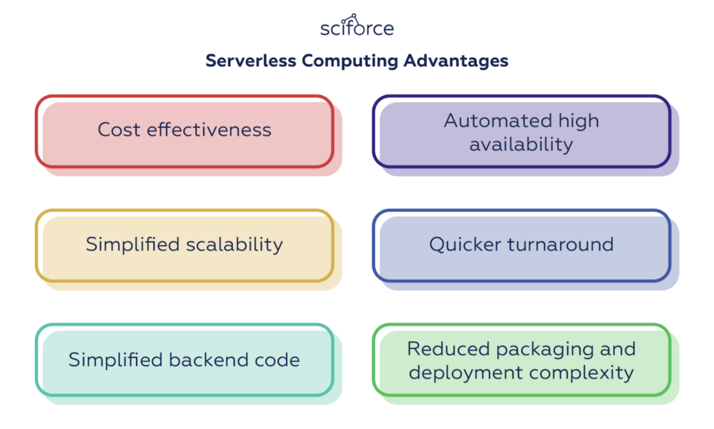
ADVANTAGES / DISADVANTAGES

Slide 22
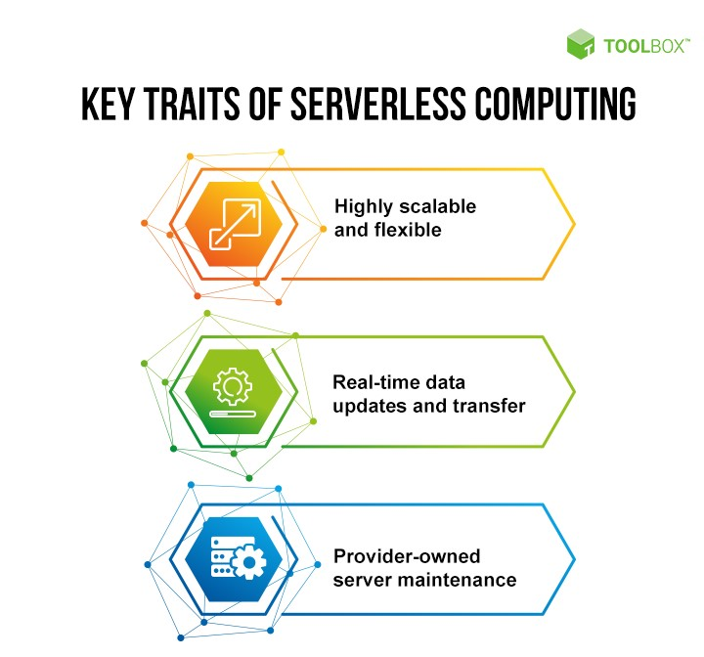
-:KEY TRAITS OF SERVER COMPUTING:-

Slide 23
STEPS FOR CREATING SERVERLESS IMAGE
*Once Signed In to the AWS Management Console, Make the default AWS Region as US East (N. Virginia) us-east-1.*
STEP-1: Create Two Amazon S3 Buckets .
1. Navigate to the Services menu in the top, then click on S3 in the Storage
section.
2. Click on Create Bucket button.
3. Bucket Name: Enter orignalbucket
Note: Every S3 bucket name is unique globally, so create the bucket with a name not currently in use.
upload an image in your bucket
4. AWS Region: Select US East (N. Virginia) us-east-1

Slide 24
6. Once the bucket is created successfully, Select your S3 bucket.
• Click on the Copy ARN button to copy the ARN.
• Save the source bucket ARN in a text file for later use.
• arn:aws:s3:::mysourcebucket12345
7. Create Destination Bucket
• Click on Create bucket button.
• Bucket Name: Enter mydestinationbucket12345
• Note: Every S3 bucket name is unique globally, so create the bucket with a name not currently in use.
AWS Region: Select US East (N. Virginia) us-east-1
Leave other settings as default and click on the Create bucket button.
8. Once the bucket is created successfully,
• Click on the Copy ARN button to copy the ARN.
• Save the destination bucket ARN in a text file for later use.
• arn:aws:s3:::mydestinationbucket12345

Slide 25
STEP-2: Create an IAM Role.
1. In the left menu, click on Roles. Click on the Create role button.
2. Select Lambda from AWS Services list.
• From Trusted Entity Type: Select AWS Service
• From Use case: Select Lambda
• Click on Next button.
• Filter Policies: Now you can see a list of policies. Here you have to select two
policies: s3 full access and AWSLambdaExecute
• Select your policy and click on the Next button.
• Role Name: Enter myrole
• Click on the Create Role button.
2. You have successfully created an IAM role by name myrole.

Slide 26
STEP-4: Create a Lambda Function.
1. Make sure you are in the US East (N. Virginia) region.
2. Go to the Services menu and click on Lambda under Compute section.
3. Click on the Create a function button.
• Choose Author from scratch
• Function name : Enter mylambdafunction
• Runtime : Select python 3.7
• Role: In the permissions section, click on Change default execution role and then select Use an
existing role.
• Existing role: Select myrole from the list.
4. Click on the Create function button.
5. If you scroll down a little bit, you can see the Code source section.
6. click on upload from and select .zip
.... Createthumbnail handler code and download it from below link
https://s3-us-west-2.amazonaws.com/us-west-2-aws-training/awsu-
spl/spl88/2.3.prod/scripts/CreateThumbnail.zip
7. go to runtime settings and click on edit
.... change the handler name “CreateThumbnail.handler”

Slide 27
STEP-5: Create a event.
1. click on test.
2. create an test event.
Create the test event and modify the json code with your
bucket name and the key to your image you just upload, save
and test.
Go and upload a second image into “original-bucket” and it will
automatically be resized and moved to “processed-bucket”.

Slide 28
-:PROJECT 2 END:-
THANK YOU

